Slide 1
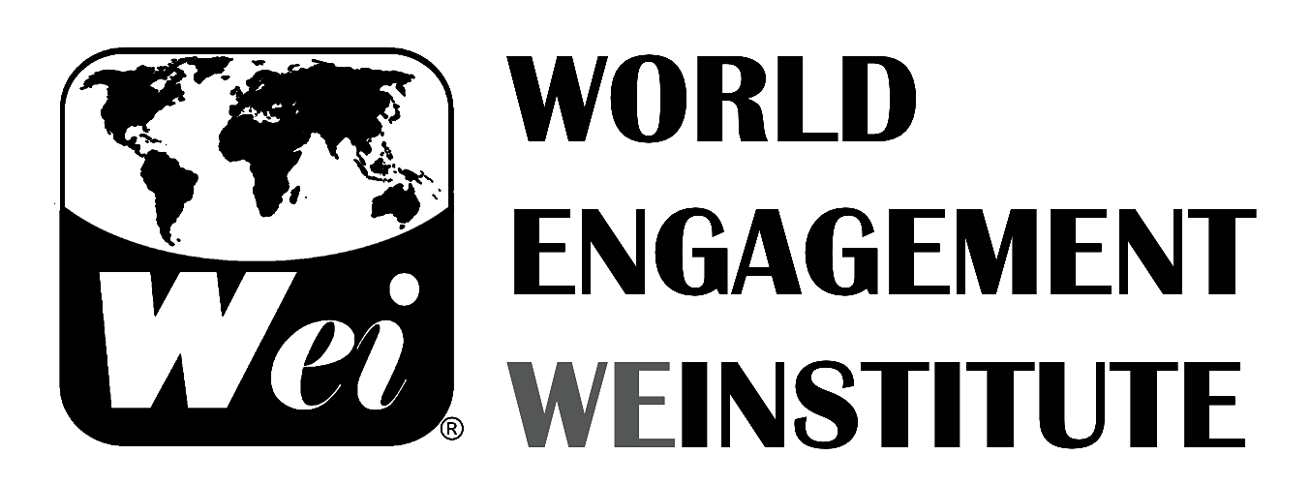
ANTI-HUMAN TRAFFICKING
Training Program

Slide 2
The Program
Certificate in Combatting Trafficking in Persons in Southeast Asia

Slide 3
Content
Trafficking in Persons (TIP) is a complex human security issue that must be addressed through collaborative, international, intercultural and multi-disciplinary engagement. This international capacity building training program is an example. The training centers on legal, practical and intercultural insights for preventing, protecting, prosecuting and partnering to combat trafficking of human being from different reasons (sexual exploitation or forced labor) as recognized by the United Nations Office on Drugs and Crimes (UNODC), by the U.S. Trafficking in Persons (TIP), the EU/EC and various international nongovernmental organizations (INGOs). Training participants will learn directly from team of international experts, legal advocates, government officials, enforcement officers and women rights NGOs. Program instructors are experienced faculty from American, European and Southeast Asia academic institutions. Participants will obtain a Combatting Trafficking in Persons (CTIP) certification from the World Engagement Institute (WEI).

Slide 4
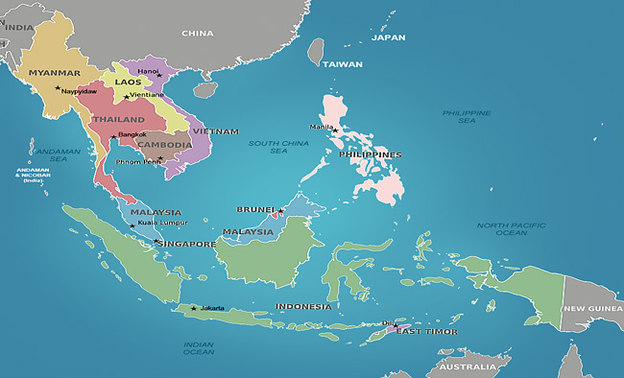
Southeast Asia
UN Southeast Asia Countries: Cambodia, Laos, Burma (Myanmar), Thailand, Vietnam, Brunei, Malaysia, East Timor, Indonesia, Philippines, Christmas Island, and Singapore

Slide 5
Learning Outcomes
At the end of the program, participants will be able to:
Identify the complex, interdisciplinary and international cases and effects behind the practice of human trafficking for sexual purposes and forced labor.
Comprehend the international, regional and national criminal law and human rights implications in anti-human trafficking.
Compare and integrate the human trafficking 4Ps of elements of prosecution, protection, prevention and partnerships.
Recognize and analyze the systemic, economic, educational, cultural, religious other elements in relation to human trafficking and human insecurity.
Identify, collaborate and communicate feasible solutions to specific contextual issues in human trafficking.

Slide 6
Multi-stakeholder Approach
Human trafficking is a complex and multifaceted phenomena that requires multi-stakeholder coordinated responses. It is an multi-billion dollar illegal industry violating human rights through criminal or exploitative activities of vulnerable people, especially women and children, within a country or trans-nationally. There is a growing recognition that trafficking in people is not just a transnational crime and violation of human rights but also a crucial issue in social and economic development. Therefore, human trafficking is a human security issue. Combating human trafficking requires the expertise, resources and efforts of many individuals and entities, including government agencies, nongovernmental organizations, businesses, justice sector, and law enforcement. It requires partnerships among all of these entities to make a positive impact.

Slide 7
The 4P Paradigm
The "4P" Paradigm – Prevention, Protection, Prosecution, and Partnership serves as a fundamental international framework to combat contemporary forms of slavery worldwide. The U.S. Department of State's Office to Monitor and Combat Trafficking in Persons employs diplomatic, economic, political, legal, and cultural tools to advance this paradigm worldwide. Secretary of State Hillary Rodham Clinton in 2009 introduced the "fourth P" – Partnership – in accordance to the United Nation's (UN) trafficking in persons protocol and the United States' Trafficking Victims Protection Act (TVPA).

Slide 8
Introductory video on A-HT by UNODC
Better future:
https://www.youtube.com/watch?v=Ddx-bj6Y8hQ

Slide 9
"In recent years we've pursued a comprehensive approach reflected by the three Ps: prosecution, protection, and prevention. Well, it's time to add a fourth: partnership. The criminal network that enslaves millions of people crosses borders and spans continents. So our response must do the same. So we’re committed to building new partnerships with governments and NGOs around the world, because the repercussions of trafficking affect us all." – Hillary Rodham Clinton, Secretary of State
The Organization for Security and Co-operation in Europe (OSCE)
http://www.youtube.com/watch?v=_PQdSXKfWSU

Slide 10
President Obama speaks about stopping human trafficking at the Clinton Global Initiative in New York City (CGI, 2012)
http://www.youtube.com/watch?v=vuMk-JGcPUQ

Slide 11
Program Calendar
Day 1 (Tuesday May 27)
Module 1: Human Trafficking
Module 2: Child Trafficking
Module 3: Labor Trafficking and Domestic Workers
Module 4: Organ Trafficking
Module 5: Sex Trafficking
Day 2 (Wednesday May 28)
Module 6: Prevention
Module 7: Protection
Module 8: Prosecution
Module 9: Partnerships
Day 3 (Thursday May 29)
Module 10: Reintegration
Module 11: Southeast Asia and the Philippines
Module 12: Call to Action

Slide 12
Module 1: Human Trafficking

Slide 13
Definition

Slide 14
Human Trafficking
Human trafficking: The illegal trading, either nationally or internationally, of human beings for the purpose of commercial sexual exploitation or forced labor; a modern-day form of slavery. It is the fastest growing criminal industry in the world, and second largest, tied with the illegal arms industry and second only to the drug trade. The TVPA defines "severe forms of trafficking" as: (A) sex trafficking in which a commercial sex act is induced by force, fraud, or coercion, or in which the person induced to perform such act has not attained 18 years of age; or (B) the recruitment, harboring, transportation, provision, or obtaining of a person for labor or services, through the use of force, fraud, or coercion for the purpose of subjection to involuntary servitude, peonage, debt bondage, or slavery.

Slide 15
The TIP definition
Human trafficking shall mean the recruitment, transportation, transfer, harbouring or receipt of persons, by means of the threat or use of force or other forms of coercion, of abduction, of fraud, of deception, of the abuse of power or of a position of vulnerability or of the giving or receiving of payments or benefits to achieve the consent of a person having control over another person, for the purposes of exploitation. Exploitation shall include, at a minimum, the exploitation of the prostitution of others or other forms of sexual exploitation, forced labour or services, slavery or practices similar to slavery or servitude or the removal of organs." (UN TIP Protocol, Article 3)

Slide 17
United Nations Office on Drugs and Crime
United Nations Convention Against Transnational Organized Crime, 2000 – Palermo Convention
Protocol to Prevent, Suppress and Punish Trafficking in Persons, especially Women and Children, 2002
Protocol Against the Smuggling of Migrants by Land, Sea and Air, 2002
Protocol Against the Illicit Manufacturing and Trafficking in Firearms, Their Parts and Components and Ammunition, 2002

Slide 18
Trafficking Victims Protection Act (TVPA)
TVPA: Trafficking Victims Protection Act (TVPA). Enacted in 2000 in the United States, the TVPA aims to prevent trafficking in persons, protect trafficking victims, and ensure punishment of traffickers. In connection, the Trafficking Victims Protection Reauthorization Act (TVPRA), defines the Federal Government's response to human trafficking, provides new immigration relief and benefits for eligible victims, and specifies crimes under which traffickers could be prosecuted.

Slide 19
Definition of Human Trafficking (article 3)

Slide 20
Additional International Instruments
The Convention on the Elimination of All Forms of Discrimination against Women (CEDAW), 1979
Article 6 –States Parties shall take all appropriate measures, including legislation, to suppress all forms of traffic in women and exploitation of prostitution of women.
Convention on the Rights of the Child, 1990
Article 34 - … protect the child from all forms of sexual exploitation and sexual abuse. … take all appropriate national, bilateral and multilateral measures to prevent:
(a) … child to engage in any unlawful sexual activity;
(b) … use of children in prostitution or other unlawful sexual practices;
(c) … use of children in pornographic performances and materials.

Slide 21
Trafficking as a Process
1. Recruitment Country of Origin
2. Transportation Country of Transit
3. Exploitation Country of Destination

Slide 22
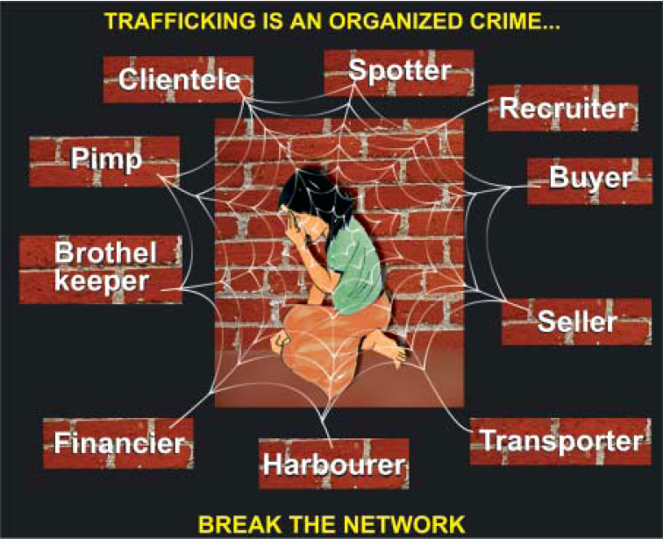
Trafficking as a Business

Slide 23
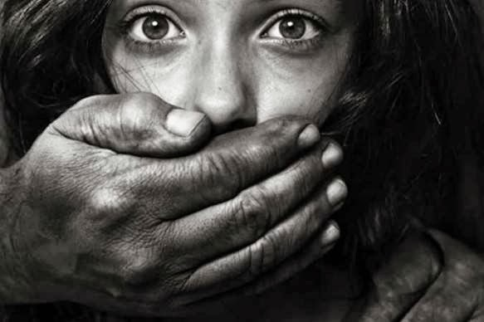
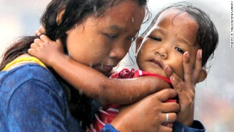
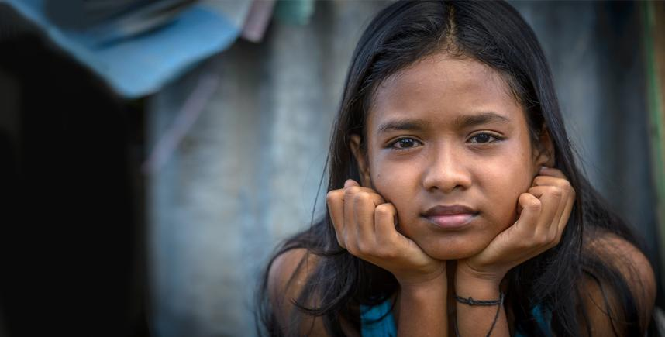
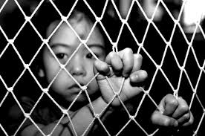
What Human Trafficking is NOT
Illegal Adoptions
Child Pornography
Prostitution

Slide 24
Module 2: Child Trafficking

Slide 25
Children in the Philippines
https://www.youtube.com/watch?v=SW5qoAKRSKE (2009)

Slide 26
Definition
“includes those children (minors under age 18) working in the worst forms of child labor (WFCL) as outlined in the International Labor Organization (ILO) Convention 182 and children engaged in work that is exploitative and/or interferes with their ability to participate in and complete required years of schooling, in line with ILO Convention 138.”

Slide 27
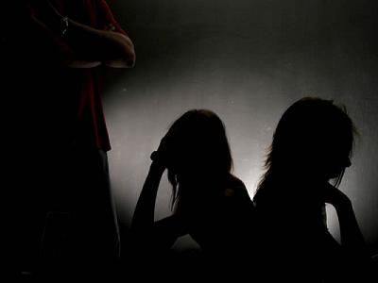
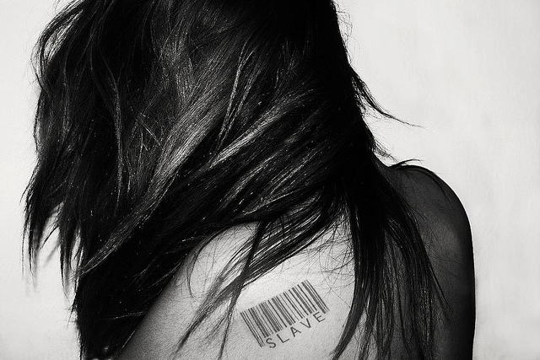
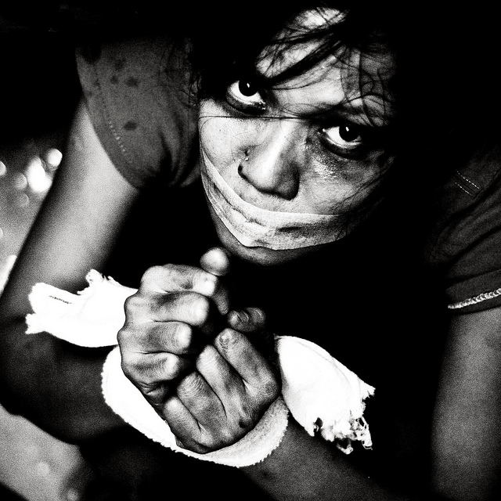
Types of Child Trafficking
Sexual Exploitation
Forced Labor
Forced Warfare

Slide 28
1. Child Sexual Exploitation
Child Sex Trafficking: According to UNICEF, as many as two million children are subjected to prostitution in the global commercial sex trade. International covenants and protocols obligate criminalization of the commercial sexual exploitation of children. The use of children in the commercial sex trade is prohibited under both U.S. law and the Palermo Protocol as well as by legislation in countries around the world. There can be no exceptions and no cultural or socioeconomic rationalizations preventing the rescue of children from sexual servitude. Sex trafficking has devastating consequences for minors, including long-lasting physical and psychological trauma, disease (including HIV/AIDS), drug addiction, unintended pregnancy, malnutrition, social ostracism, and death.

Slide 29
According to the International Labor Organization, the term commercial sexual exploitation of children is defined as:
“the exploitation by an adult with respect to a child or an adolescent – female or male – under 18 years old; accompanied by a payment in money or in kind to the child or adolescent (male or female) or to one or more third parties.”
Commercial sexual exploitation in children includes all of the following:
The use of girls and boys in sexual activities remunerated in cash or in kind (commonly known as child prostitution) in the streets or indoors, in such places as brothels, discotheques, massage parlors, bars, hotels, restaurants, etc.
The trafficking of girls and boys and adolescents for the sex trade.
Child sex tourism
The production, promotion and distribution of pornography involving children.
The use of children in sex shows (public or private).

Slide 30
2. Forced Child Labor
Forced Child Labor: Most international organizations and national laws recognize that children may legally engage in certain forms of work. There is a growing consensus, however, that the worst forms of child labor should be eradicated. The sale and trafficking of children and their entrapment in bonded and forced labor are among these worst forms of child labor. A child can be a victim of human trafficking regardless of the location of that exploitation. Indicators of forced labor of a child include situations in which the child appears to be in the custody of a non-family member who has the child perform work that financially benefits someone outside the child’s family and does not offer the child the option of leaving. Anti-trafficking responses should supplement, not replace, traditional actions against child labor, such as remediation and education. However, when children are enslaved, their abusers should not escape criminal punishment by virtue of longstanding patters of limited responses to child labor practices rather than more effective law enforcement action.

Slide 31
International Labor Organization
The definition of forced labor according to the ILO Convention 29 is considered to be:
“All work or service which is exacted from any person under the menace of any penalty and for which the said person has not offered himself voluntarily.”
Forced labor is the second most commonly identified form of human trafficking (18%), and the ILO estimates that in 2012 nearly 20.9 million people were victims of forced labor globally. Of these, 4.5 million are in forced commercial sexual exploitation, and 14.2 million are in other forms of labor exploitation

Slide 32
Methods of Control
Debt-Bondage
Personal documents
Wages
Safety
Freedom
Working and Living Conditions

Slide 33
1. Debt-Bondage
Debt-bondage: An illegal practice in which traffickers tell their victims that they owe money (often relating to the victims’ living expenses and transport into the country) and that they must pledge their personal services either for labor or commercial sex to repay the debt.

Slide 34
2. Personal Documents

Slide 35
3. Wages

Slide 36
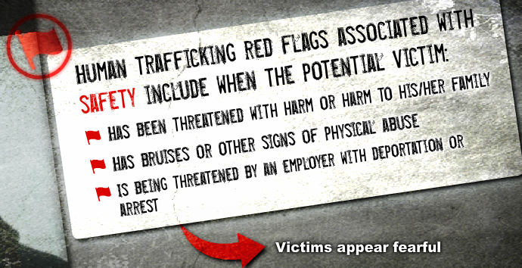
4. Safety

Slide 37
5. Freedom

Slide 38
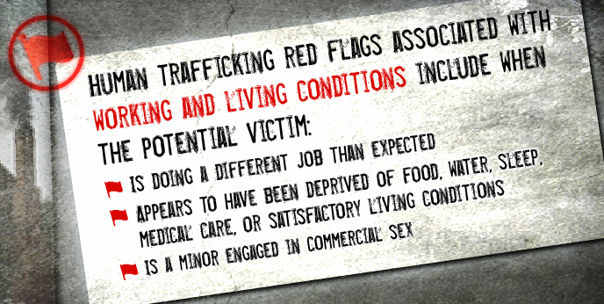
6. Working and Living Conditions

Slide 39
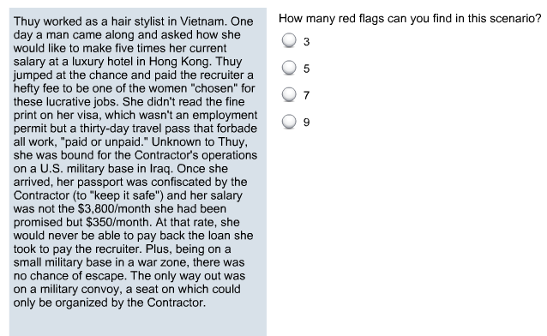
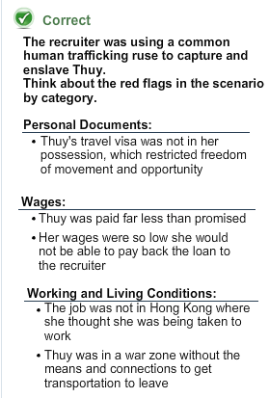
Case Study

Slide 40
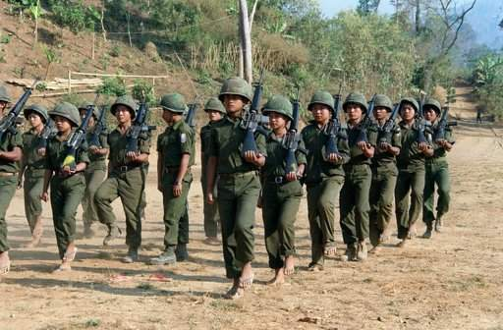
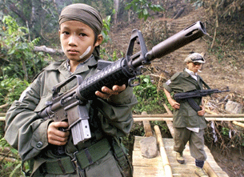
3. Forced Warfare
Child Soldiers: Child soldiering can be a manifestation of human trafficking where it involves the unlawful recruitment or use of children—through force, fraud, or coercion—as combatants, or for labor or sexual exploitation by armed forces. Perpetrators may be government forces, paramilitary organizations, or rebel groups. Many children are forcibly abducted to be used as combatants. Others are made unlawfully to work as porters, cooks, guards, servants, messengers, or spies. Young girls can be forced to marry or have sex with male combatants. Both male and female child soldiers are often sexually abused and are at high risk of contracting sexually transmitted diseases.

Slide 41
Child Soldiers
According to the Paris Principles on the involvement of Children in Armed Conflict, a child soldier is:
“a child associated with an armed force or armed group refers to any person below 18 years of age who is, or who has been, recruited or used by an armed force or armed group in any capacity, including but not limited to children, boys and girls, used as fighters, cooks, porters, spies, or for sexual purposes.”
In the Child Soldiers Prevention Act of 2008 (CSPA), the term “child soldier” means:
Any person under 18 years of age who takes a direct part in hostilities as a member of governmental armed forces;
Any person under 18 years of age who has been compulsorily recruited into governmental armed forces;
Any person under 15 years of age who has been voluntarily recruited into governmental armed forces; or
Any person under 18 years of age who has been recruited or used in hostilities by armed forces distinct from the armed forces of a state.

Slide 42
Case Study
THAILAND – Tola was seven years old when she was lured away from her parents by a couple who owned the field her family worked. While enslaved, she was forced to take care of cats and dogs for the couple’s pet grooming shop. For five years, Tola’s parents hoped to see her again, never knowing how she disappeared or where she might be. They never imagined that Tola was close, enduring torture and abuse. If Tola did not do her job properly, she was kicked, slapped, and beaten with a broom. Sometimes the couple locked her in a cage and poured boiling hot water over her. On one occasion, the traffickers cut off her ear lobe with a pair of scissors. One day, she climbed a concrete fence of the house while chasing a cat and realized she was free. A neighbor called the police and she was taken to a nearby shelter where her mother identified her. The coupled was arrested and charged with various charges including torture, detaining a person against their will, enslavement, and kidnapping. The couple posted bail and escaped. As for Tola, injuries on her arms affected her muscles; she can no longer move her left arm. For now, she is safe with her family and is beginning her mental, emotional, and physical journey to recover.

Slide 43
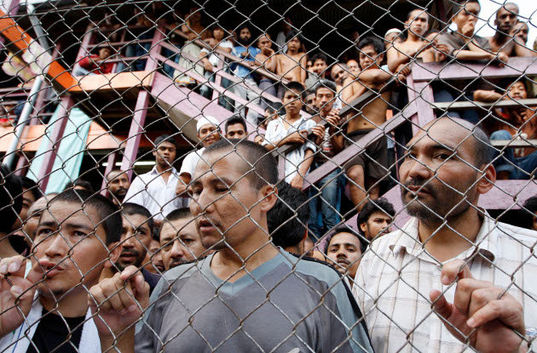
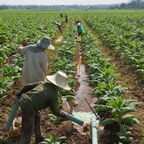
Module 3: Labor Trafficking and Domestic Workers

Slide 44
Labor Trafficking Definition
The Trafficking Victims Protection Act of 2000 (TVPA) defines labor trafficking as:
“The recruitment, harboring, transportation, provision, or obtaining of a person for labor or services, through the use of force, fraud or coercion for the purpose of subjection to involuntary servitude, peonage, debt bondage or slavery.”

Slide 45
Common Patterns of Labor Trafficking
Victims are often kept isolated, their activities restricted and they are typically watched, escorted or guarded by associates of traffickers. It is likely that traffickers will “coach” them to answer questions with a cover story about being a student or tourist to prevent detection.
Victims may be blackmailed by traffickers using the victims’ status as an undocumented alien or their participation in an ‘illegal’ industry. By threatening to report them to law enforcement or immigration officials, traffickers keep victims compliant.
People who are trafficked often come from unstable and economically devastated places as traffickers frequently identify vulnerable populations characterized by oppression, high rates of illiteracy, little social mobility and few economic opportunities.
Women and children are overwhelmingly trafficked in labor arenas because of their relative lack of power, social marginalization, and their overall status as compared to men.

Slide 46
Resulting Health Problems
Physically
Scars, headaches, hearing loss, cardiovascular/respiratory problems, limb amputation, chronic back pain, visual and respiratory problems;
Emotionally
Traumatic Bonding or “Stockholm Syndrome,” which is characterized by cognitive distortions where reciprocal positive feelings develop between captors and their hostages. This bond is a type of human survival instinct and helps with victim cope with the captivity.
Psychologically
Helplessness, shame, and humiliation, shock, denial and disbelief, disorientation and confusion, and anxiety disorders including posttraumatic stress disorder (PTSD), phobias, panic attacks, and depression.

Slide 47
Domestic Workers Definition
Victims of forced labor have been found in nearly every job setting or industry imaginable including private homes, factories, restaurants, elder care and medical facilities, hotels, housekeeping, childrearing, agriculture, construction and landscaping, food processing, meat-packing, and cleaning services.
Such workplaces are informal and often not shared with other workers. Both children and adults are subject to involuntary domestic labor. While it is not easy for authorities to inspect private homes many investigators report that there are many cases of untreated illnesses and, tragically, widespread sexual abuse.

Slide 48
Push & Pull Factors
Push
Aspirations for a better life
Political instability
Militarism
Civil unrest
Internal armed conflict
Natural disasters
Pull
Expansion of multimedia and technology
Porous borders
Corruption
Unprotected migration

Slide 49
Prevention of Push & Pull Factors
In response to the above root causes, most prevention strategies fall within one of the following categories, according to the UNODC:
Reducing the vulnerability of potential victims through social and economic development
Discouraging the demand for the services of trafficked persons
Public education
Border control
Preventing the corruption of public officials

Slide 50
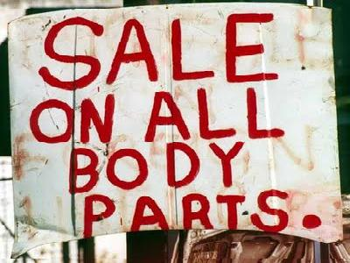
Module 4: Organ Trafficking

Slide 51
Definition
The United Nations Office on Drugs and Crime believe that organ trafficking is an international organized crime that involves many offenders. The different types of offenders include the recruiter (who identifies the vulnerable person), the transporter, the hospital/health clinic staff, the medical professionals, the middlemen and contractors, the buyers, and the bank’s employees (where the organs are stored) are all involved. According to the United Nations Regional Information Centre for Western Europe, the most common trafficked organs are kidney, liver, heart, lung and pancreas.

Slide 52
Categories of Organ Trafficking
1. Traffickers force or deceive their victims into giving up an organ.
2. Victims formally or informally agree to sell an organ and are cheated because they are paid less than the promised price for the organ or they are not paid at all.
3. Vulnerable persons are treated for an ailment, which may or may not exist, and their organs are removed without the victim’s knowledge.

Slide 53
International Standards
The UN Protocol to Prevent, Suppress and Punish Trafficking in Persons
Includes “organ removal” and its subsequent sale as an end purpose of trafficking.
Optional Protocol on the sale of children, child prostitution and child pornography (2000) to the UN Convention on the Rights of the Child (1989)
This protocol states that the sale of children for the purpose of transferring their organs for profit should be a criminal offense.
World Health Organization (WHO)
The Guiding Principles on Human Organ Transplantation (1991) of WHO state that the commercialization of human organs is ‘a violation of human rights and human dignity’.
An Additional Protocol to the European Convention on Human Rights and Biomedicine Concerning Transplantation of Organs and Tissues of Human Origin (2002)
This protocol prohibits organ and tissue trafficking, deriving a financial gain or comparative advantage from the human body and its parts and calls on States to provide appropriate sanctions for such trafficking.

Slide 54
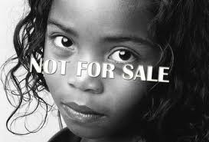
Module 5: Sex Trafficking

Slide 55
The 2013 Trafficking in Persons Report sees sex trafficking as one of the most severe forms of human trafficking in persons. Sex trafficking is defined as:
“(a) a situation where a commercial sex act is induced by force, fraud, or coercion, or in which he person induced to perform such an act has not attained 18 years of age; or (b) the recruitment, harboring, transportation, provision, or obtaining of a person for labor or services, through the use of force, fraud, or coercion for the purpose of subjection to involuntary servitude, peonage, debt bondage, or slavery.”

Slide 56
Case Study
UNITED STATES - Mauri was only 16 years old when she was prostituted on the streets of Honolulu, Hawaii. For her, there was no escape; her pimp threatened to kill her family if she did not go out on the street night after night to make him money. If Mauri tried to use some of the money to buy food, she was severely beaten. Mauri finally escaped when she was picked up by law enforcement. She is now in a rehabilitation program and has reunited with her parents, but her road to recovery has been long and difficult. She suffers from terrible flashbacks and severe depression, and has even attempted suicide. Mauri says she was lucky to get out alive: “The longer you stay the less hope you have.”

Slide 57
4P Paradigm
Prevention
Protection
Prosecution
Partnership
4P Paradigm: The “4P" paradigm – prevention, protection, and prosecution is the fundamental international framework used across the world to combat contemporary forms of slavery. More recently, a "fourth P" – partnership – has been added as a pathway to progress in the effort against modern slavery. The paradigm is outlined in the United Nation's (UN) trafficking in persons protocol and the United States' Trafficking Victims Protection Act (TVPA).

Slide 58
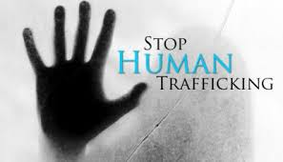
Module 6: Prevention

Slide 59
Define Prevention
According to the United States Agency for International Development (USAID) prevention is considered to be:
“education about trafficking for vulnerable populations, for employers whose business practices may facilitate or constitute trafficking, and for first responders in a position to identify and help rescue or support trafficking victims, such as social workers, health care professionals, police, and humanitarian aid staff.”

Slide 60
P1: Prevention
Awareness campaigns
Rectifying laws that omit classes of workers from labor law protection
Providing robust labor enforcement
Implementing measures that address significant vulnerabilities such as birth registrations and identification
Carefully constructing labor recruitment programs that ensure protection of workers from exploitations
Strengthening partnerships between law enforcement, government, and non-governmental organizations to collaborate, coordinate, and communicate more effectively
Emphasizing effective policy implementation with stronger enforcement, better reporting, and government-endorsed business standards
Tackling this global crime at its root causes by monitoring product supply chains and reducing demand for commercial sex.

Slide 61
Module 7: Protection

Slide 62
Define Protection
According to USAID protection programs focus on:
“the identification of trafficked persons and the development of national and regional referral mechanisms that ensure survivors are provided shelter, food, counseling, legal assistance, as well as repatriation or reintegration services.”
Key victim protection efforts include the "three R’s" –
Rescue
Rehabilitation
Reintegration

Slide 63
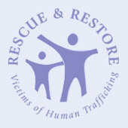
P2: Protection
Protection programs provide services to victims of human trafficking, including:
Shelters
Security
Access to other health services
Immigration relief
Health counseling
Legal and reintegration assistance

Slide 64
Identification Process
The identification process is the most important part of protection programs.
Potential characteristics of victims include:
Was recruited to work one job and is now in another
A minor selling sex for money
Has been threatened with harm
Does not have access to identification papers
Freedom of movement is limited
Shows signs of physical or sexual abuse
Appears to have been drugged or deprived of food

Slide 65
Victim Identification Strategies
Governments could:
Empower front line responders, beyond just the police, to identify victims
Recognize that offenders can be victims
Establish regulations, agreements, or standard operating procedures with NGOs to identify victims
Employ a taskforce model or multidisciplinary approach

Slide 66
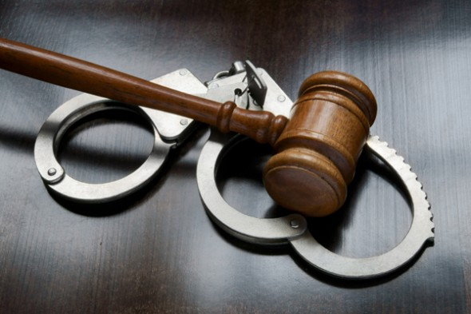
Module 8: Prosecution

Slide 67
Define Prosecution
The TIP Report assesses individual countries’ efforts to prosecute trafficking offenders, as per the Trafficking Victims Protection Act (TVPA)'s minimum standards and the 2000 UN Convention on Transnational Organized Crime.
Criminal penalties to meet this standard should include,
a maximum of at least 4 years' deprivation of liberty
a more severe penalty.
Imposed sentences should involve,
significant jail time (with a majority of cases resulting in sentences on the order of 1 year of imprisonment or more)
Sentences should take into account,
the severity of an individual's involvement in trafficking
imposed sentences for other grave crimes
the judiciary's right to hand down punishments consistent with that country’s laws.

Slide 68
Legal Systems
General principles that must apply to all trafficking cases:
Victims of trafficking should be identified as victims of crime
Victims should never be treated as criminals
Victims should never be treated only as a source of evidence
Primary support measures for victims must include:
Information and Communication
Emotional Support
Direct assistance

Slide 69
Moving Forward
What must we do?
Implement international policies and practices that encourage civil participation and cooperation with trafficking victims in the prosecution of the traffickers
Technical training for all social actors
Technical cooperation among countries and international law enforcement agencies
Extendwitness protection services

Slide 70
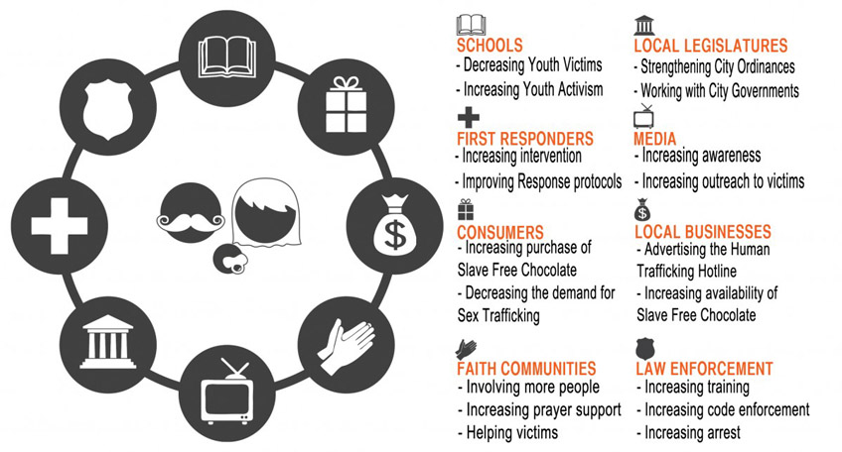
Module 9: Partnerships

Slide 71
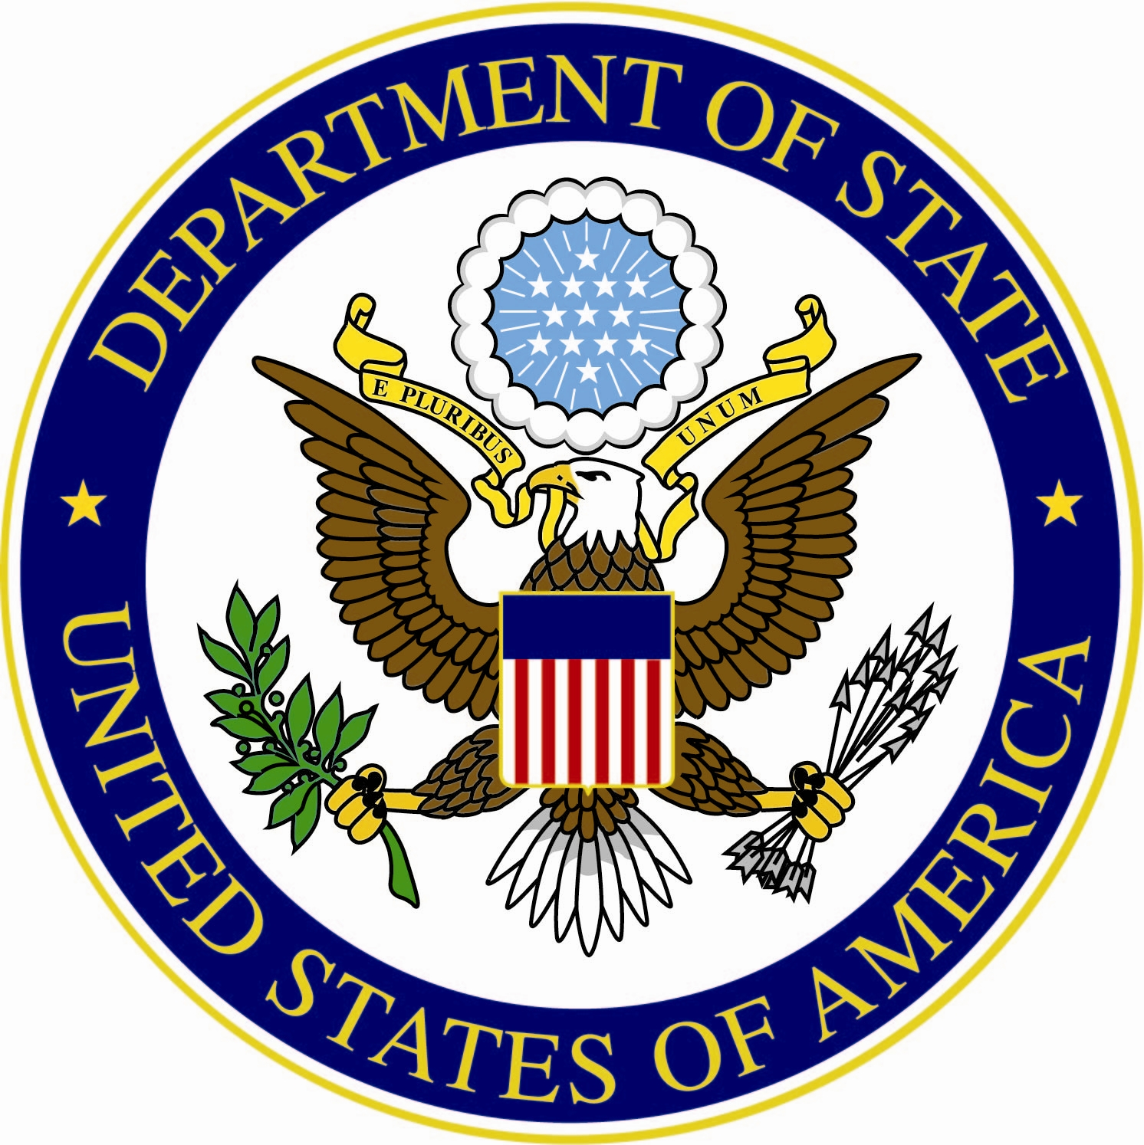
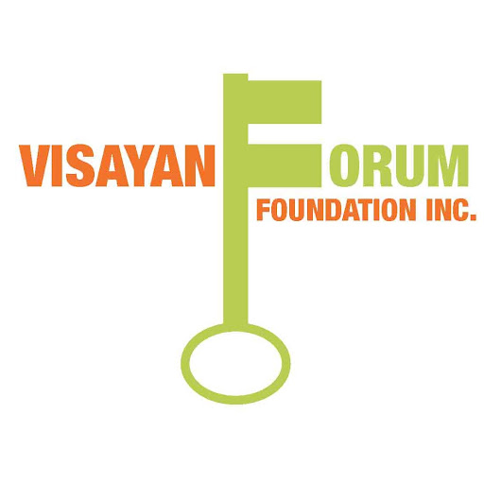
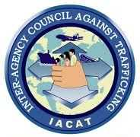
Define Partnerships
Combating human trafficking requires the expertise, resources and efforts of many individuals and entities. It is a complex, multi-faceted issue requiring a comprehensive response of government and nongovernment entities in such areas as human rights, labor and employment, health and services, and law enforcement. It requires partnerships among all of these entities to have a positive impact.

Slide 72
Examples of Partnerships
Task forces among law enforcement agencies that cooperate to share intelligence, work across jurisdictions, and coordinate across borders
Alliances between governments and business associations that seek to craft protocols and establish compliance mechanisms for slavery-free supply chains
Regional partnerships among nations, such as the anti-human trafficking efforts of the Organization of American States (OAS) or the European Union (EU).
Coalitions of nongovernmental organizations (NGOs) coming together for purposes of advocacy, service provision, information sharing, and networks of survivors, whose experiences inform the broader trafficking movement.

Slide 73
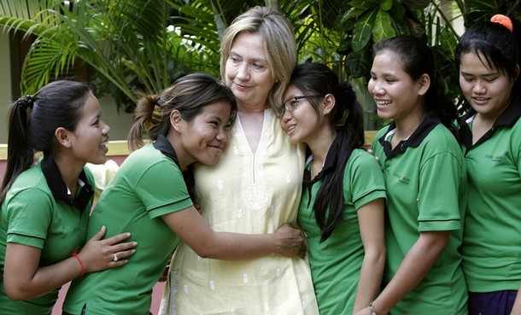
Module 10: Reintegration

Slide 74
Define Reintegration
Reintegration into society is one of the most difficult challenges of the anti-human trafficking process.
One factor that comes into play when helping someone to reintegrate into society include the fear of the unknown.
Victims of human trafficking face major problems through reintegration including social stigma and personal emotional scars that must be overcome.
Victimized women may have been treated by law authorities as criminals, either for prostitution or illegal migration, and, therefore face additional problems of employment or other forms of reintegration.

Slide 75
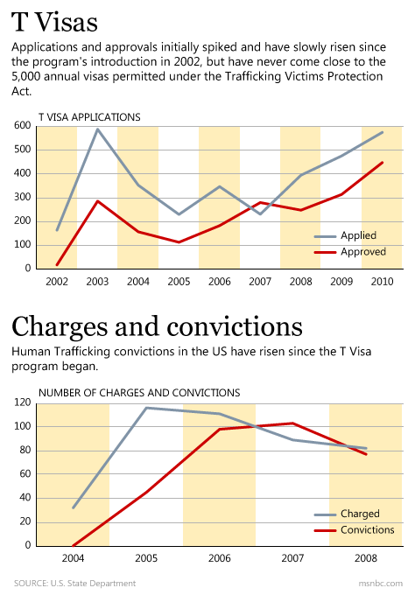
Effective Reintegration Strategies
Immediate assistance (housing, food, medical, safety and security, language interpretation and legal services);
Mental health assistance (counseling);
Income assistance (cash, living assistance); and,
Legal status (T-visa, immigration, and certification).

Slide 76
How the TVPA helps victims
Enabling trafficking victims to obtain medical care, witness protection, other types of social service assistance
Enabling victims to obtain legal immigration status
Criminalizing trafficking
Permitting prosecution where victim’s service compelled by confiscation of documents
Increasing prison terms for all slaver violations from 10 years to 20 years; adding life imprisonment for death, kidnapping or sexual abuse of victim

Slide 77
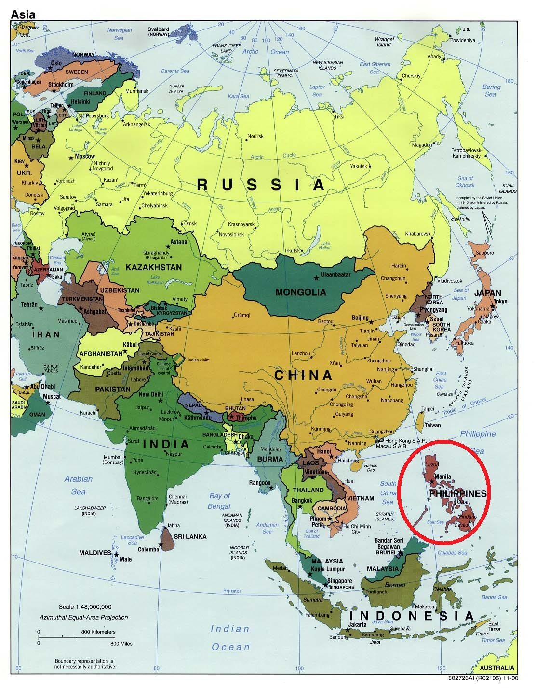
Module 11: Southeast Asia and the Philippines

Slide 78
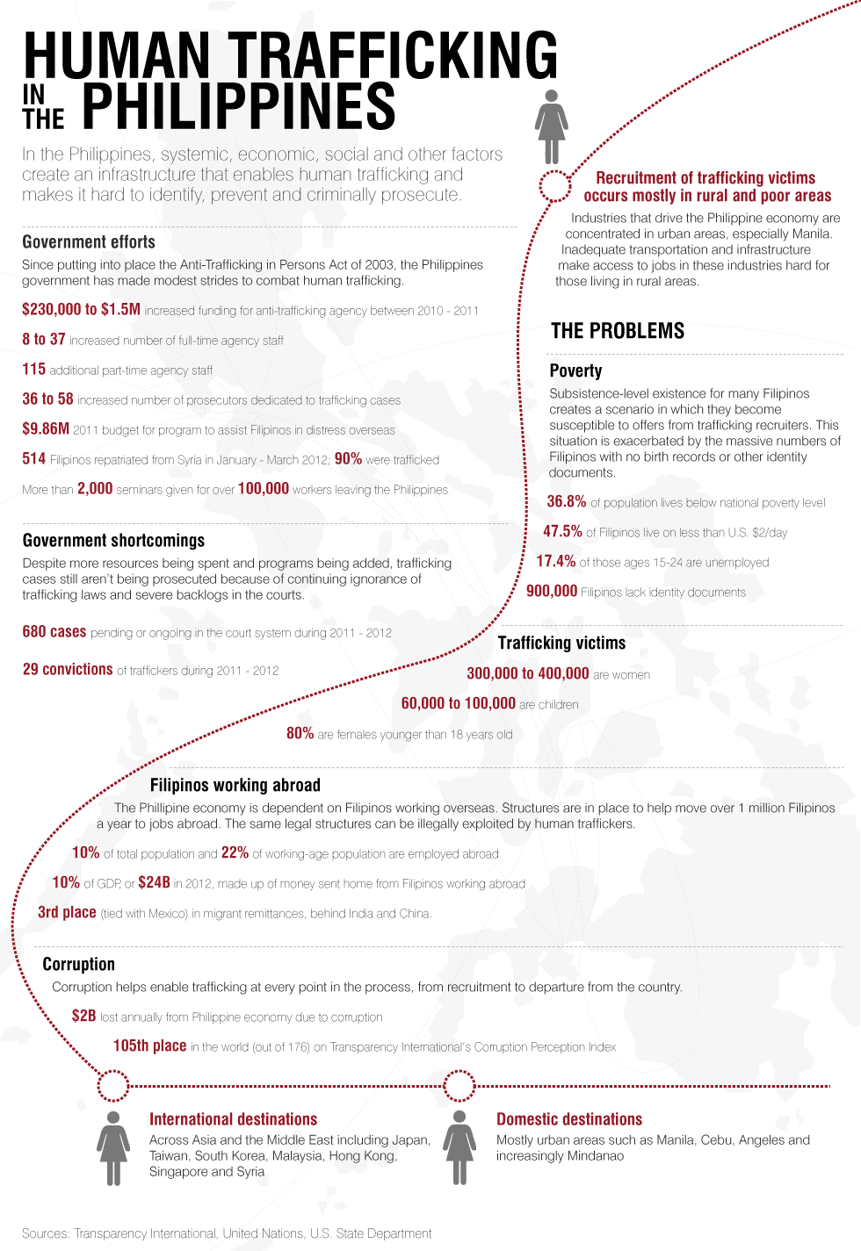

Slide 80
The Philippines
According to the U.S. State Department’s 2013 TIP Report,
“the Philippines is a source country and, to a much lesser extent, a destination and transit country for men, women, and children subjected to sex trafficking and forced labor. Many Filipina women are subjected to sex trafficking in other Asian countries and abroad, including Malaysia, Singapore, Republic of Korea, and China. Trafficking of men, women, and children within the country also remains a significant problem. People are also trafficked from rural areas to urban areas. Hundreds of victims are subjected to sex trafficking each day in well-known and highly visible business establishments that cater to Filipinos and foreign tourists’ demand for commercial sex acts.”

Slide 81
2013 TIP Tier Ranking
Tier 1
Countries whose governments fully comply with the TVPA’s minimum standards for the elimination of trafficking.
Tier 2
Countries whose governments do not fully comply with the TVPA’s minimum standards but are making significant efforts to bring themselves into compliance with those standards.
Tier 2 Watch List
Countries where governments do not fully comply with the TVPA’s minimum standards, but are making significant efforts to bring themselves into compliance with those standards, and
the absolute number of victims of severe forms of trafficking is very significant or is significantly increasing;
there is a failure to provide evidence of increasing efforts to combat severe forms of trafficking in persons from the previous year, including increased investigations, prosecution, and convictions of trafficking crimes, increased assistance to victims, and decreasing evidence of complicity in severe forms of trafficking by government officials; or
the determination that a country is making significant efforts to bring itself into compliance with minimum standards was based on commitments by the country to take additional steps over the next year.
Tier 3
Countries whose governments do not fully comply with the TVPA’s minimum standards and are not making significant efforts to do so.

Slide 82
The Philippines = Tier 2
The Philippine government:
criminally prohibits both sex and labor trafficking through its 2003 Anti-Trafficking in Persons Act;
Issued new regulations in 2009 that facilitate the immediate closure of establishments suspected of using children for commercial sex acts;
Future issues to address:
Substantial backlog in trafficking cases pending in Philippine courts;
Lack of vigorous efforts to pursue criminal prosecution of labor traffickers, including labor recruitment companies involved in the trafficking of migrant workers abroad;
Rampant corruption at all levels that enables traffickers and undermines efforts to combat trafficking; and
Uneven and insufficient efforts to identify and adequately protect victims of trafficking – particularly those who are assisting with prosecutions.

Slide 83
Risk Factors in the Philippines
Conflict between MILF and the Armed Forces of the Philippines (AFP) left between 128,000 and 160,000 vulnerable individuals displaced in 2010,
Poverty, population growth, and dependency burdens have lead some parents to see child labor as a means to cope with meager family incomes.
Pervasive and persistent poverty, especially in rural areas, high unemployment and underemployment and constraints to small and medium enterprises growth are a few of the challenges facing the Filipino labor force that have led many to migrate for work.
Presence of a large informal economy, estimated to be between 40-80% of Filipino workers, who are for the most part not registered or recorded in official statistics and are beyond the reach of social protection and labor legislation.
An estimated 900,000 undocumented Filipinos, mostly based in Mindanao, whose lack of official documentation contributes to the population’s vulnerability to trafficking.
An established organized crime network that plays upon the above factors and fraudulently recruits persons for jobs that are in reality forced labor situations.
Persistent law enforcement officials’ complicity in human trafficking and corruption at all levels of government that enables traffickers to prosper.
www.humantrafficking.org.

Slide 84
Prevention in the Philippines
Numerous government agencies conducted seminars and training sessions for government officials and community members, and the government provided funding to two NGOs to implement additional awareness campaigns.
The Philippine Overseas Employment Agency (POEA) conducted 862 pre-employment orientation seminars for over 150,000 prospective and outbound Filipino overseas workers, and the Commission on Filipinos Overseas (CFO) held targeted counseling programs for groups considered at-risk.
The IACAT conducted a two-day anti-trafficking awareness seminar for media professionals in a region known to be a center of trafficking.
In January 2013, the government enacted the Domestic Workers Act, which provides specific protections to domestic workers including mandatory daily and weekly rest periods and the prohibition of recruitment fees charged to workers by a private agency or third party.
TIP 2013, p. 303

Slide 85
Protection in the Philippines
In 2012, the government allocated $615,000 to the Department of Social Welfare and Development (DSWD) to fund the Recovery and Reintegration Program for Trafficked Persons.
The government reported the majority of the 2,569 victims assisted by DSWD received skills training, shelter, medical services, and legal assistance under this program.
The government established a center for male victims, but at the close of the reporting year it was not yet fully operational.
The government followed formal procedures to identify and assist victims and refer them to government or NGO facilities for short- and long-term care.
TIP 2013, pg. 302

Slide 86
Prosecution in the Philippines
IACAT launched its Operations Center Witness Location Program, which located 25 witnesses and victims willing to testify in cases, and assisted 88 witnesses attending hearings;
DOJ increased the number of victims assisted by its witness protection program from 18 to 60, but the majority of victims did not have access to this form of protection.
In February 2013, the government enacted an amendment to its 2003 law that defined additional acts as constituting trafficking in persons and included provisions for the prosecution of attempted trafficking.
The new law also provides for extraterritorial jurisdiction of trafficking crimes committed by Filipino citizens or legal residents or against Filipino citizens abroad.
During the reporting period, 227 cases were filed with the DOJ for potential prosecution, but it is unknown how many cases were prosecuted. The government convicted 24 trafficking offenders, a decrease from the 29 traffickers convicted during the previous year; three convictions were for labor trafficking, a slight increase from the two labor trafficking convictions obtained during the previous year.
TIP 2013, pg. 301

Slide 87
Partnerships in the Philippines
An international NGO assisted the government with seven of the 19 cases that resulted in convictions.
IACAT independently conducted 90 training sessions for government and NGO stakeholders and 14 in cooperation with other partners, police trained 1,616 officers working on women and children’s desks, and NGOs and foreign donors provided additional training to law enforcement officers.
TIP 2013, pg. 300-303

Slide 88
Effective Strategies for Change
The U.S. Department of State suggests specific recommendations to all relevant countries and for the Philippines to improve their efforts they must:
1. Increase efforts to investigate, prosecute, and convict an increased number of both labor and sex trafficking offenders implicated in the trafficking of Filipinos within the country and abroad;
2. Address the significant backlog of trafficking cases by developing mechanisms to track and monitor the status of cases filed with the Department of Justice (DOJ) and those under trial in the courts;
3. Conduct immediate and rigorous investigations of complaints of trafficking complicity by government officials and ensure accountability for leaders that fail to address trafficking-related corruption within their areas of jurisdiction;
4. Ensure the government’s armed forces or paramilitary groups supported by the government do not recruit or use children;

Slide 89
Effective Strategies for Change
5. Continue to strengthen anti-trafficking training for police recruits, front-line officers, and police investigators; increase the number of government officials whose duties are dedicated solely to anti-trafficking activities;
6. Continue and improve collaboration between victim service organizations and law enforcement authorities with regard to law enforcement operations;
7. Make efforts to expand the use of victim processing centers to additional localities to improve identification of adult victims and allow for victims to be processed and assisted in a safe environment after a rescue operation;
8. Examine “offloading” policies to ensure this practice does not interfere with individuals’ freedom of movement;
9. Increase victim shelter resources and expand the government shelter system to assist a greater number of trafficking victims, including male victims of sex and labor trafficking;
10. Increase funding for the DOJ’s witness protection program and facilitate the entry of trafficking victims into the program; increase efforts to identify trafficking victims in destination countries and to pursue criminal investigation and prosecution of their traffickers; and
11. Develop and implement programs aimed at reducing the demand for commercial sex acts, including child sex tourism.

Slide 90
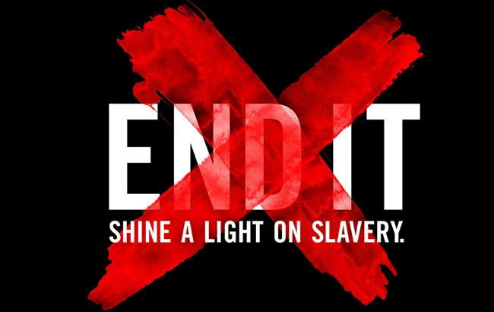
Module 12: A Call to Action

Slide 91
What concrete steps will you take to combat human trafficking in your neighborhood, state, or country? Create a short flow chart or concrete steps you will take that will help you reach your goal.

Slide 92
Combatting Human Trafficking Essential Resources

Slide 97
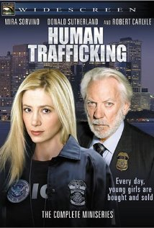
Human Trafficking (Movie, 2005)
Human Trafficking is a television miniseries about an American Immigration and Customs Enforcement agent going undercover to stop an organization from trafficking people, and shows the struggles of three trafficked women. It premiered in the United States on Lifetime Television on October 24 and 25, 2005 and was broadcast in Canada on Citytv on January 2 and 3, 2006. It stars Mira Sorvino, Donald Sutherland, Rémy Girard, and Robert Carlyle. Watch it HERE.

